Slide 1
PHASE 3: ANALYSIS ON NYC ILLEGAL REVENUES
By - Abul Hasan Fazulullah
UBID# 1011913
Siddharth Selvam
UBID# 1031196

Slide 2
INTRODUCTION -
The terms quality, luxury and life style goes hand in hand when we say New York city.
Though the city is small in terms of area , it does not make it hard for it to be in the third spot for the most expensive city to live in USA.
Most expensive area: Manhattan Average home price: $1,621,965 Average rent: $3,783 Half gallon of milk: $2.72 T-bone steak: $14.30 Monthly energy bill: $232.72 Doctor visit: $105.00
What the surprising part here is that , most of the residents of the NYC don’t know much about the expenses in the city.
The power of the NYC is with their top – notch finance department. They know how to make the city run even during the nights.
How do they run the city and what is their source of income ?
Fact - Comparing to Connecticut, New York is 65% more expensive.

Slide 3
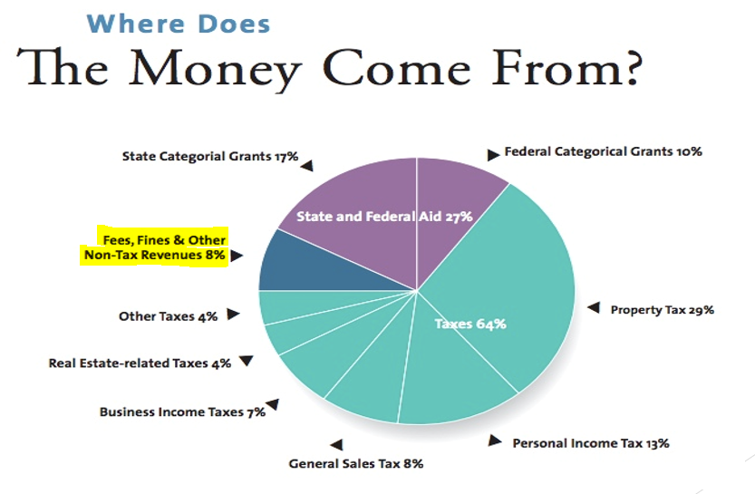
SOURCE -
Based on the
fiscal year
2017

Slide 4
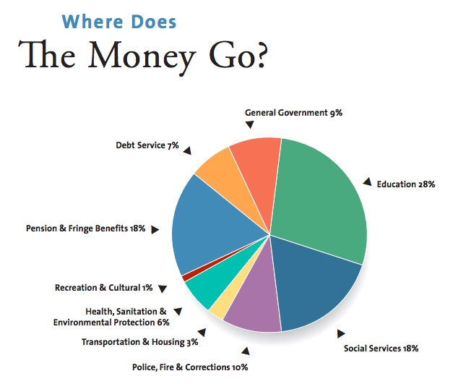
DISTRIBUTION -
Based on the
fiscal year
2017

Slide 5
PURPOSE -
The money that is being generated by the NYC is of two ways one being the visible money and the other being the dark money.
We love the dark side and our major concern is with the dark money that the NYC makes out of the New Yorkers with out their knowledge.
The main aim of this project is to showcase the illegal ways in which new York city makes money to run the city.
The following are the references, that aid us to prove our statement –
https://www.inverse.com/article/15564-how-new-york-city-s-open-data-revealed-the-nypd-was-issuing-illegal-parking-tickets
http://iquantny.tumblr.com/post/144197004989/the-nypd-was-systematically-ticketing-legally
https://www.theguardian.com/cities/2016/jul/26/open-data-blogger-parking-tickets-new-york-nypd

Slide 6
Hidden Ticket -
When referred the links above and when made a study on them we found out that the NYC makes illegal money by the parking tickets.
At first shocked by the small method they use to fill their finance department, it was quite a surprise but the numbers made them clear and straight.
Mayor’s Management Report (MMR) – MMR is issued twice yearly by the Mayor’s Office of Operations.
It is the city’s main published source of information about government agency performance.
The MMR provides narrative and statistical information on the activities of city departments and agencies.
FACT - UPS, FedEx, and other commercial delivery companies receive up to 7,000 parking tickets a DAY, contributing up to $120 million in revenue for the city of New York.

Slide 7
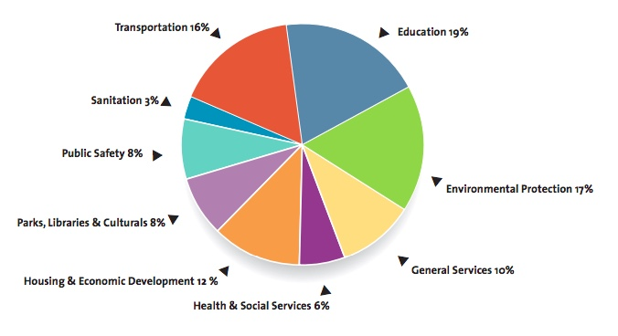
MMR –
Based on the
fiscal year
2017

Slide 8
SHORTCOMINGS -
The budget that they published does not match with the expenses occurred in the year 2017.
Example – Budget says 19% for education but a total of 28% has been spent on education.
The city’s constitutional debt limit, from the statement of debt affordability, is $90.2 billion in 2017 and $97.2 billion in 2018.
When we take the previous year’s debts, we were able to find that the debt increases every year. Comparing to the early 2000s, the debt right now is very high. The city has to figure out some solutions to pay off all the debts.
How the government is able to match with the expenses ?
Fact - Measure to make sure that you really are parked closer than 15 feet to the NYC fire hydrant. Investing in a $5 tape measure could save you $115 and the hassles of a NYC parking ticket.

Slide 9
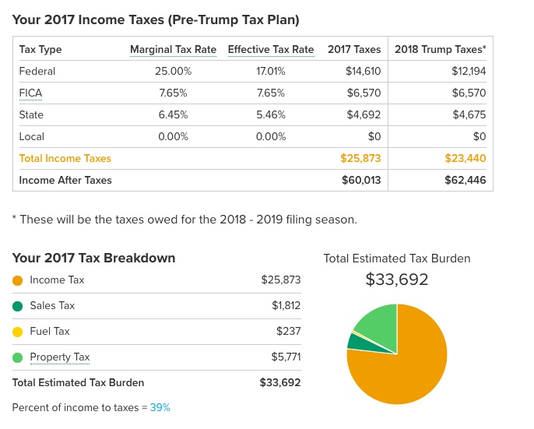
PRE-TRUMP TAX PLAN -
When we researched over the tax reports, we found that the taxes has been cut down in the past year. This is what they call as “Pre-trump Tax Plan”.

Slide 10
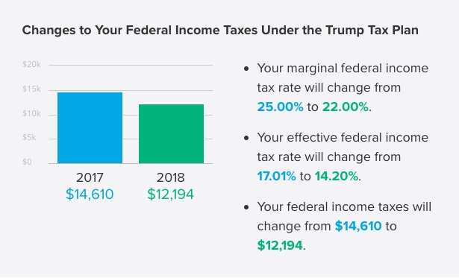
DIFFERENCES -

Slide 11
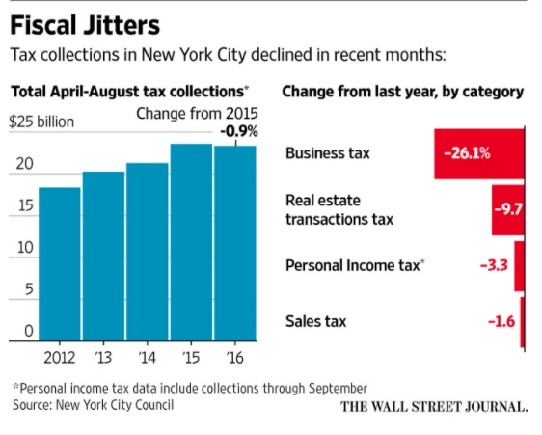
DECLINE -
The weakening in tax collections this year has particularly worried council budget officials and government watchdogs because of the sharp growth of the city’s budget since Mr. de Blasio, a Democrat, took office in 2014.
The budget has grown to about $82 billion from about $70 billion in 2014.
NYC also have to cover the tax differences to run the government. How ?

Slide 12
PROBLEM DEFINITION -
The aim of this project is to analyze and calculate the illegal money that the New York City is making from parking tickets.
There are more than 10 million vehicle parking violation tickets issued every year in New York City.
Estimated $765 million has been charged for parking violation in 2016, before the late fees and excluding towing charges. The major contribution comes from the illegal parking tickets.
The illegal issuing of tickets started after 2009 change in traffic laws, it’s now legal to park in front of pedestrian ramps not connected to crosswalks in New York, but according to a big data analysis at the blog I Quant NY, police officers have still been issuing tickets, with some individual spots racking up fees worth $50,000 over just more than two years.
How much extra money that the government makes out of it ?

Slide 13
DATASET -
Source - NYPD’s dataset from the NYC OpenData repository & NYC’s Department of Finances.
We have both the datasets from Fiscal Year 2013 to Fiscal Year 2018 which comprises to approximately 5GB of textual data.
Our parking tickets dataset has approximately 54.6+M Records and 44 Attributes (FY 2013 to FY 2018) and similarly for the other set of dataset from Department of Finance.
NYC OpenData repository is the major source of information for our project.
This parking ticket dataset is real time data, which can pull up information from the NYC Open Data repository every last day of a month and store in the local storage system in CSV file format.
Since the data is dynamic, it requires data cleaning process all the time to correlate with the previously existing dataset. This Data Cleaning includes removing unused attributes, replacing empty spaces with NULL, and make the attributes identical to the previous datasets.

Slide 14
MODELING -
To start with that, it is more important to model our system. The important modules that we need to look into is, MapReduce module and the Spark module.
At its core, Hadoop is a distributed data store that provides a platform for implementing powerful parallel processing frameworks.
The reliability of this data store when it comes to storing massive volumes of data, coupled with its flexibility in running multiple processing frameworks makes it an ideal choice for our data hub.
The above feature makes us to store any type of data as is, without placing any constraints on how that data is processed.
Map Reduce Model –
MapReduce provides an effective environment to attain automatic parallelism.
The MapReduce runtime system handles these internal low-level details to attain parallelism.
In our MapReduce framework, we are only concerned with expressing our problem or computation in a functional programming model.

Slide 15
MODELING -
Once these functions are defined, the runtime system takes the responsibility of automatically parallelizing it on the given hardware architecture.
Map Tasks are used to split the input dataset into independent values. Each Cluster-node has a Job Tracker and a Task Tracker to take care of the data.
MapReduce operates exclusively on <Key, Value> pairs, we give the input in the same format. This Key-value classes have to be serializable by the framework and hence we implemented the writable interface.
Apache Organization suggests 82,000 maps for an input dataset with 10TB in size and 128MB block size. Also, the optimum level of parallelism for maps lies between 10 and 100.
Hence we are planning to have number of maps somewhere between 10 and 15.
Reducer includes three primary phases: Shuffle, Sort and Reduce

Slide 16
MODELING -
We use the following method to perform the reducing operation.
reduce(WritableComparable, Iterator, OutputCollector, Reporter)
The output is written in the File system using OutputCollector.collect(WritableComparable, Writable).
The right number of reduces seems to be 0.95 or 1.75 multiplied by (<no. of nodes > * mapred . tasktracker . reduce . tasks . maximum).
Increasing the number of reduces increases the framework overhead, but increases load balancing and lowers the cost of failures.
We use the core Spark APIs to operate on the data. We use the RDD API to process on the dataset.
This API performs two different operations, Transformation and actions. We also use DataFrame API.
Parking in New York City can be equated to the hunger games with over 6 million tickets issued in 2016 alone.

Slide 17
EVALUATION PLAN -
A map-reduce subroutine to find the distribution of violation types.
A map-reduce subroutine to find all the violations that have been paid.
A subroutine to identify the illegal tickets issued by the NYPD. (Reference: https://www.inverse.com/article/15564-how-new-york-city-s-open-data-revealed-the-nypd-was-issuing-illegal-parking-tickets ).
A spark program to compute the violations for vehicles in NY and all other vehicles.
A Hive program to calculate the revenue made from illegal traffic tickets by NYC and to run a cron job to identify a new ticket for a particular number plate in the dataset to avoid quadruple-ticketed.

Slide 18
PROJECT PLAN -
Initial plan would be spinning up our own Hadoop Cluster using Amazon Web Services or Google Cloud Platform.
Then we need to setup a Domain Name Server which would be easy for us to identify the nodes. For this purpose, we use CloudFlare which can take care of the Domain Names and the firewalls as well.
This can also manage the traffic and can make the request/responses pass through a secure channel than the usual http path.
This ensures that the cluster is safe and secure from the external traffic. Certificate Authorities(CAs) can be used for data encryptions which uses SHA256.
Once the cluster is setup, we also would need to have a monitoring system to monitor all the nodes in the cluster.
Our algorithms and logic comes into picture. The cluster should have the Hadoop environment and the block size approximately equals 128MB.
This ensures that the MapReduce jobs and Spark could be made run on the system. The output of the implementation is stored in one of those nodes which is typically same as storing in the local file system(HDFS).

Slide 19
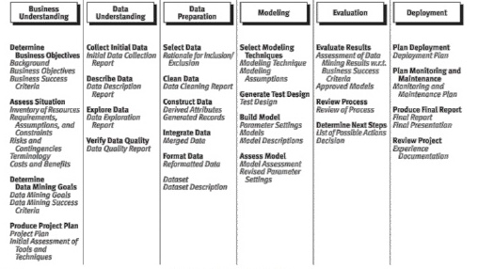
STEPS -

Slide 20
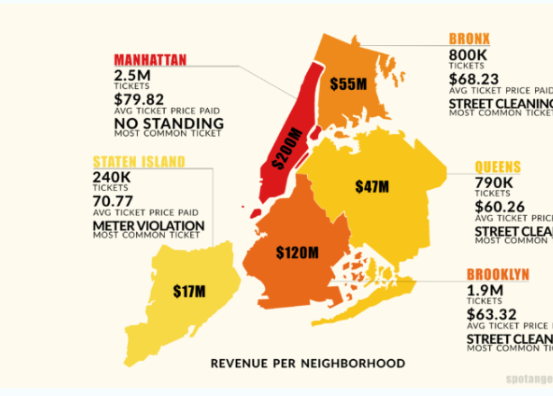
CONCLUSION -
This project would be a great informational resource for people who reside in New York.
Also, working on this project helped us to understand how these technologies and infrastructures are built and would help us in solving a Big Data problem.

